Slide 1


Atliq Hardware
Consumer Good
Ad hoc Insights
Presented by Abhishek Kumar
Data
Analytics
SQL Project Challenge

Slide 2
Project Overview
Atliq Hardware (imaginary company) is one of the leading computer hardware producers in India and well expanded in other countries too.
However, the management noticed that they do not get enough insights to make quick and smart data-informed decisions.
They want to expand their data analytics team by adding several junior data analysts.
Tony Sharma, their data analytics director wanted to hire someone, who is good at both tech and soft skills.

Slide 3
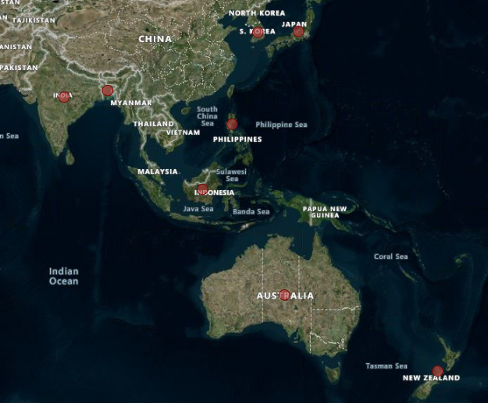

Request 1 Provide the list of markets in which customer "Atliq Exclusive" operates its business in the APAC region.

Slide 4
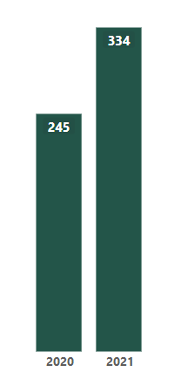

Request 2 What is the percentage of unique product increase in 2021 vs. 2020?
Insight
Demand and production both increase by 36.33% in 2021 compare to 2020

Slide 5
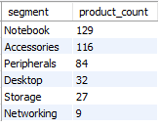
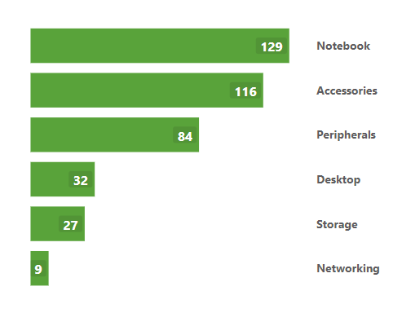
Request 3 Provide a report with all the unique product counts for each segment and sort them in descending order of product counts.
Insight
Segment notebook, accessories and peripherals show significant manufacturing growth and contributing 83% to the total manufacturing product

Slide 6
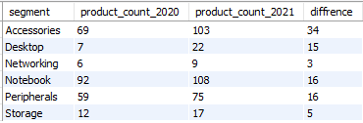
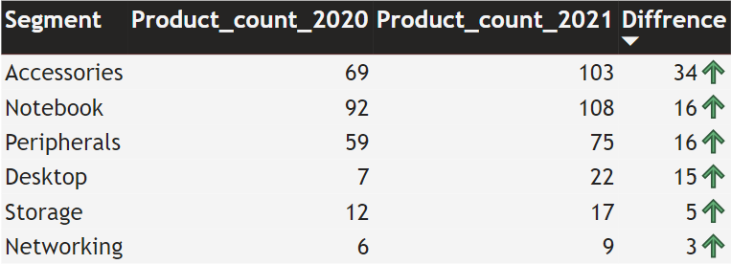
Request 4 Follow-up: Which segment had the most increase in unique products in 2021 vs 2020?
Insights:
Accessories has largest increase in production.
Storage and networking are experiencing slower production growth than other segment

Slide 7
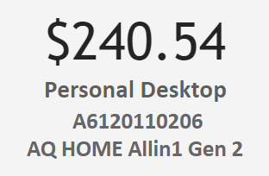

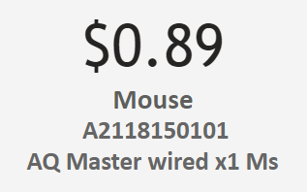
Request 5 Get the products that have the highest and lowest manufacturing costs.
Insights:
Mouse: AQ Master wired x1 Ms (Variant: Standard1) has the lowest manufacturing cost
Personal Desktop: AQ Home Allin 1 Gen 2 (Variant: Plus 3) has the highest manufacturing cost

Slide 8
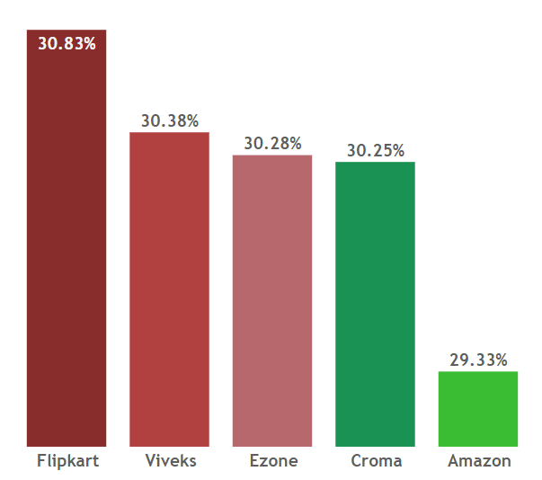
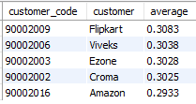
Request 6 Generate a report which contains the top 5 customers who received an average high pre_invoice_discount_pct for the fiscal year 2021 and in the Indian market
Insight:
The highest average pre invoice discount was given to Flipkart
The lowest average pre invoice discount was given to Amazon

Slide 9
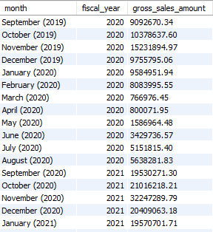
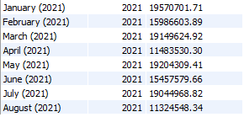
Request 7 Get the complete report of the Gross sales amount for the customer “Atliq Exclusive” for each month. This analysis helps to get an idea of low and high-performing months and take strategic decisions.
FY 2020
79.5 M
Insights:
The lowest Gross sales total for both fiscal year is in March (2020).
The highest Gross sales total for both fiscal year is in November (2020).
73.8% of Total Gross sales figure in FY 2021
FY 2021
224.4 M

Slide 10
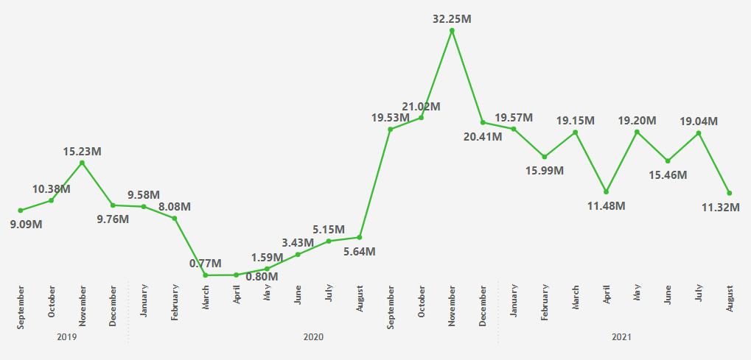
2020
Highest growth sales 32.2M
2021
Lowest growth
Sales 0.77M

Slide 11
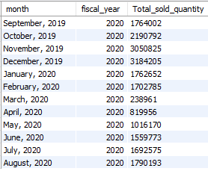
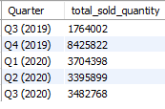
Request 8 In which quarter of 2020, got the maximum total_sold_quantity? The final output contains these fields sorted by the total_sold_quantity,

Slide 12
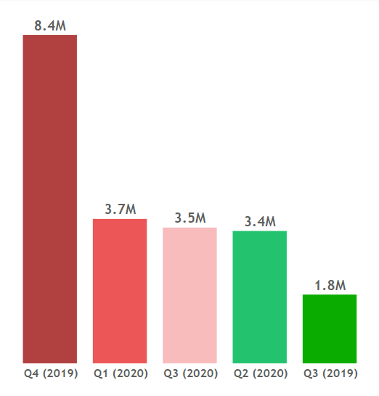
Insight:
The highest total sold quantity of Quarters 4 (Q4 (2019)) of FY 2020 is 8.4 M
Quarter 4 (2019) account for approximately 40.56% of total sold quantity

Slide 13
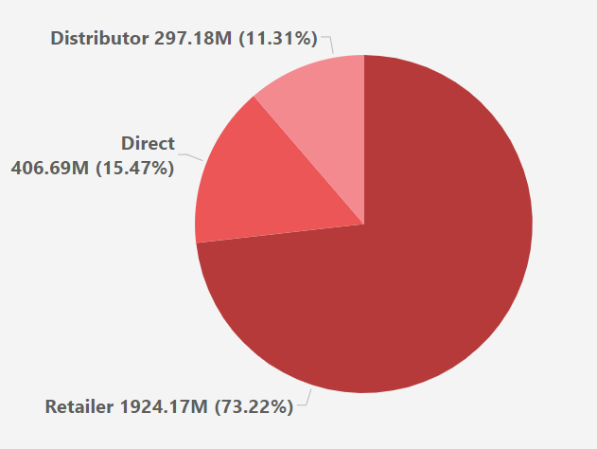

Request 9 Which channel helped to bring more gross sales in the fiscal year 2021 and the percentage of contribution?
Insight:
Channel “Retailers” bring the highest gross sales to the company with 73.22%
Channel “Distributor ” makes the least contribution at a percentage of 11.31%

Slide 14
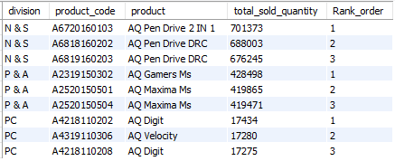
Request 10 Get the Top 3 products in each division that have a high total_sold_quantity in the fiscal_year 2021?

Slide 15
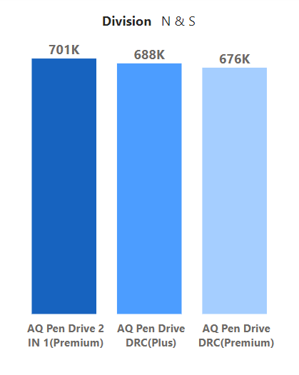
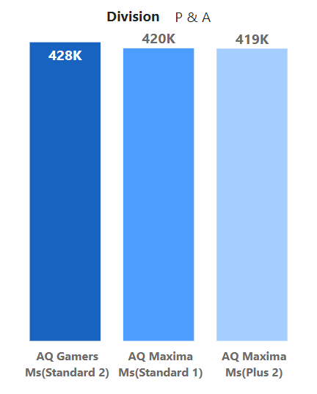
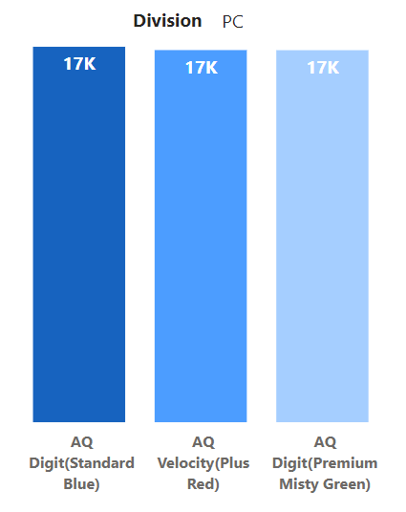
Lowest sold product
Highest sold product

Slide 16
Thank you

